Slide 1
17th May, 2019 Single-Cell Omics
Computational practical of Strand-seq Part 1:
From fastq to chromosome overview plot
¹David Porubsky, ²Hyobin Jeong
¹Dichler Lab, Department of Genome Sciences, University of Wachington
²Korbel Group, Genome Biology, EMBL
Notes:
check if you put all your 2017 lab meeting presentations on the korbel drive under \shared\presentations_group\2016

Slide 2
Which data do we analyze today?
RPE (Retinal pigment epithelial) cell lines will be analyzed
RPE-1 is commonly used to study patterns of SV and genomic instability
C7 was generated via gamma-irradiation of RPE cells followed by selection on soft agar as an indicator for cellular transformation (Riches et al. 2001)
BM510 was generated via silencing the mitotic spindle machinery and constructing an anchorage-independently growing cell line, which is likely to exhibit a variety of SV classes.
RPE1-WT
Practical
Wednesday
RPE1-C7
RPE1-BM510

Slide 3
Processing the Strand-seq library after sequencing
Input: Paired-end fastq files : *_1_sequence.txt.gz *_2_sequence.txt.gz
Step1. Align reads, mark duplicates, add read groups
bwa mem -t {threads} \ -R '@RG\tID:{params.name}\tSM:{SAMPLE_NAME}\tLB:{wildcards.cell}' \ {params.genome} \ {input} \ | samtools view -bT {params.genome} - \ > {output}
bammarkduplicates markthreads={threads} I={input} O={output} index=1 rmdup=0
Step2. Filter & count bins in fixed windows
Rscript {params.qc_plot} {input.counts} {input.info} {output}
Step3. Plots and statistics
Rscript {params.sv_plot} {input} plot_chromosomes/{SAMPLE_NAME}/window_{wildcards.window}
Don’t worry, we can do it with one touch using Snakemake!
Notes:
Single-Cell RNA-Seq Reveals AML Hierarchies Relevant to Disease Progression and Immunity

Slide 4
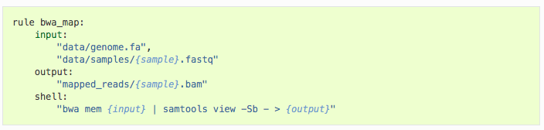
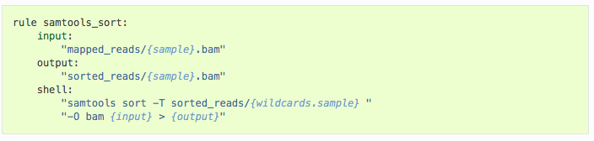
Workflow management with Snakemake
Snakemake is a Python-based workflow management tool
It can run workflows consisting of multiple inter-dependent tasks. These can be computed either locally or on the cluster.
Intermediate results are stored, so the pipeline only executes what is left to do.
See http://snakemake.readthedocs.io or https://bitbucket.org/snakemake/snakemake/overview
Notes:
Single-Cell RNA-Seq Reveals AML Hierarchies Relevant to Disease Progression and Immunity

Slide 5

Step1: Download and install the pipeline
Original script was developed by Sascha Meiers: https://git.embl.de/meiers/strand-seq-pipeline
It’s stored in an in-house git code repository https://git.embl.de/
git clone https://github.com/jeongdo801/Strand_seq_practical_computational.git Practical_C7
cd Practical_C7
tar -xvzf practical.tar.gz
cd practical
less Snakefile
Notes:
Single-Cell RNA-Seq Reveals AML Hierarchies Relevant to Disease Progression and Immunity

Slide 6
Step2: Add sequencing data to the pipeline
Tell the pipeline which data to use by copying/linking files into a fastq subdirectory
Strand-seq raw data is stored here:
/g/korbel/shared/data/others/StrandSeq
Strand-seq analysis data is typically stored on
/g/korbel2/StrandSeq
We will start with 10 cells from RPE-1 C7
mkdir fastq
cd fastq
wget -O H2KT2AFXY_C7x02_18s002199-1-1_Raeder_lane1C7x02PE20301_1_sequence.txt.gz https://www.dropbox.com/s/kayg7n0l7mm88wq/H2KT2AFXY_C7x02_18s002199-1-1_Raeder_lane1C7x02PE20301_1_sequence.txt.gz?dl=0
wget -O H2KT2AFXY_C7x02_18s002199-1-1_Raeder_lane1C7x02PE20301_2_sequence.txt.gz https://www.dropbox.com/s/pit8jt3858z5ug2/H2KT2AFXY_C7x02_18s002199-1-1_Raeder_lane1C7x02PE20301_2_sequence.txt.gz?dl=0
...
Notes:
Single-Cell RNA-Seq Reveals AML Hierarchies Relevant to Disease Progression and Immunity

Slide 7
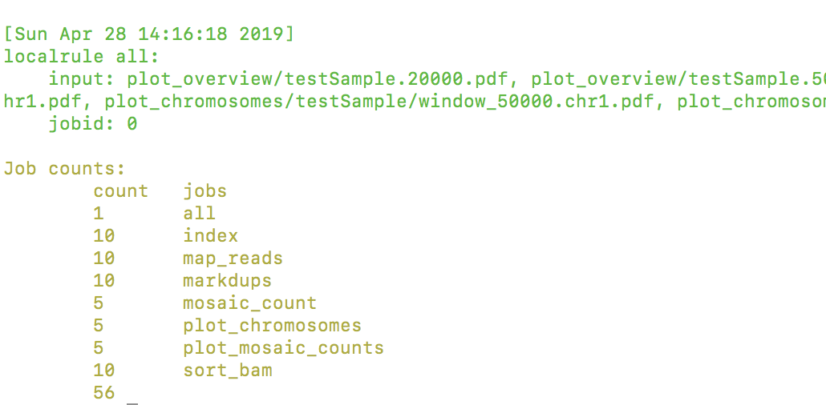
Step3: Set the sample and execute the pipeline
Edit the Snakemake file to specify the sample name and potentially other variables.
Using snakemake -n you can see which jobs are going to be computed. Run snakemake locally or on the cluster.
cd ../
vi Snakefile
#Change the sample name testSample into C7_data
#Save with :wq
snakemake -n
snakemake -j 4 # Compute locally using 4 cores
Notes:
Single-Cell RNA-Seq Reveals AML Hierarchies Relevant to Disease Progression and Immunity

Slide 8
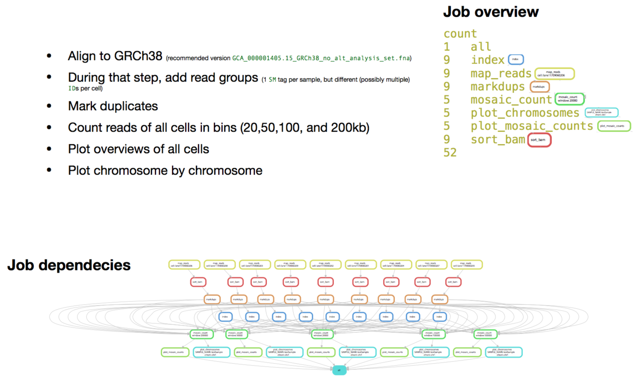
What will be happened in the pipeline?

Slide 9
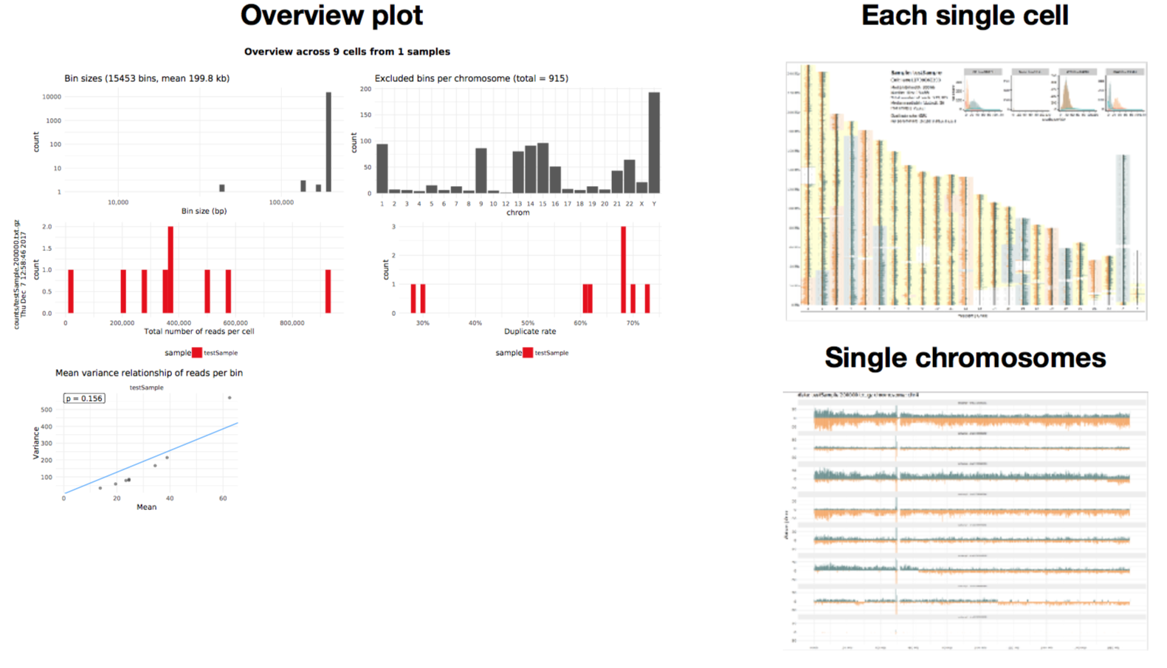
Output of the pipeline
Three different plots for quality checking and first look for the SVs
Bam files from this pipeline will be used as an input of downstream advanced analysis

Slide 10
Challenges
After finishing the pipeline (~1h), let’s explore the overview plot of C7. What are the clonal SVs and what are the SCEs of the C7?
Compare the RPE-1 C7 and BM510 overview plot, which SVs are in common, and which SVs are specific to BM510 or C7?
RPE1-WT
RPE1-C7
RPE1-BM510

Slide 11
Hint for the challenges
#You can explore the processing result of BM510 as follows:
Overview plot:
Chromosome plot:

